Slide 1
Research Methods in Psychology
By: Habtemariam K.

Slide 2
Lecture Outline
Experimental Research
Descriptive Research
Correlational Research

Slide 3
Research Concepts
Psychologists are interested in determining the causes of mental events and behaviors
“What is the impact (effect) of divorce on children?”
Issues in Theory:
Systematic way of organizing observations
Hypotheses are proposed relations between variables (cause-effect relationships)
Variable: Any phenomenon that can vary along some dimension
Continuous: varies continuously (body weight)
Categorical: can take on fixed values (gender)

Slide 4
Defining Experiments
Experiments ask whether systematic variation in one variable produces variation in another variable
Independent variable (IV): Manipulated by experimenter
Dependent variable (DV): Participants response
Example: The effect of coffee on academic achievement.
IV: Coffee
DV: Academic achievement

Slide 5
Issues in Experimental Research
Control group: A group that is similar to the experimental group, except that it has not been exposed to the treatment.
Experimental group :exposed to independent variable or conditions expected to create change.

Slide 6
Full population of interest
Randomly assign into control and experimental groups
Experimental group
Control group

Slide 7
Limitations of Experimental Research
Complex real-world issues may not be easily studied in the laboratory
The focus of experimental psychology is off-base: The interpretative stance suggests that we should strive to understand the personal meanings that govern behavior rather than focus on predicting behavior

Slide 8
Descriptive Research
The descriptive approach seeks to describe phenomena rather than to manipulate variables
Methods of descriptive research:
Case studies
Naturalistic observation
Survey research

Slide 9
Case Studies
An in-depth study of the behavior of one person or a small group
Used when large numbers of subjects are not available
Often used in clinical research
Freud’s case study approach
Drawbacks include
Small sample size (limit to generalizability)
Susceptibility to researcher bias

Slide 10
Naturalistic Observation
In-depth study of a phenomenon in its natural setting
Examples include:
Study of primate behavior in the wild
Piaget’s study of the cognitive development of his own children
Advantage: Naturalistic studies have good generalizability
Disadvantages:
Observation per se can alter behavior
Observational technique cannot infer cause of behavior
© 1999 John Wiley and Sons, Inc.

Slide 11
Survey Research
Survey technique asks questions of large numbers of persons to gain information on attitudes and behavior
Two approaches:
Questionnaires
Interviews
Disadvantages of survey approach:
Sampling issues
People may not respond accurately
© 1999 John Wiley and Sons, Inc.

Slide 12
Correlational Research
Aim of the correlational approach is to determine the degree to which 2 or more variables are related
Can determine association between data from experiments, case studies, or surveys
Calculate the correlation coefficient (r)
Values range from -1 through 0 through +1
Negative correlations: High values of one variable are associated with low values of the other variable
Correlational studies do NOT establish causality
© 1999 John Wiley and Sons, Inc.

Slide 13
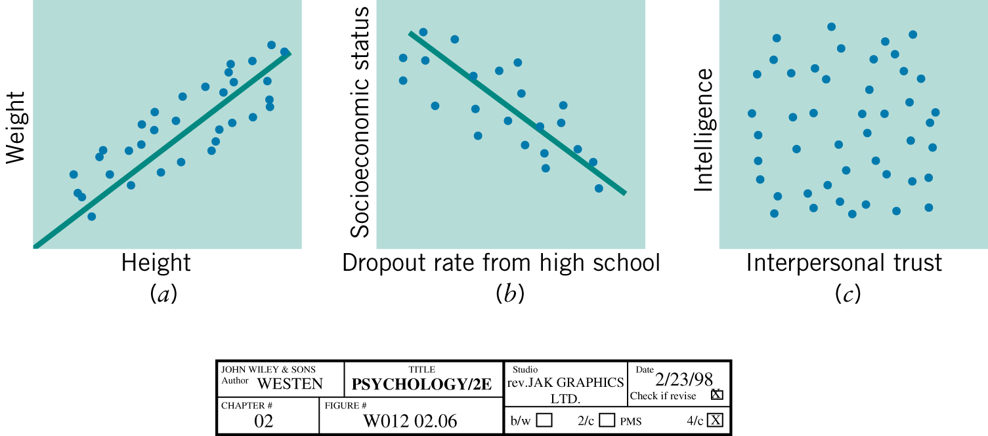
The Correlation Coefficient

Slide 14
Ethical Principles of Research
Ethics in research with human participants
-Freedom from coercion
-Informed consent
-Limited deception
-Adequate debriefing
-Confidentiality

Slide 15
Ethical Principles of Research
Ethics of research with nonhuman animals
-Necessity
-Health
-Humane treatment

